Slide 1
OOPS Introduction & Familiarization with C++
Lec-1&2
Prabhjot Kaur
Department of Computer Science and Engineering
Chitkara University, Punjab

Slide 2
Basic of Fundamentals
How your computer work.
What are number systems
What is program
Low level lang and high level lang(slow, python, syntax is small)
Compiler and interpreter
Algorithms:- set of instructions/ procedures
Flowcharts:- Diagramatical representation
C++ compiler\IDE:- VS, code blocks, DevC++, ….
Stack memory/Heap memory:-

Slide 3
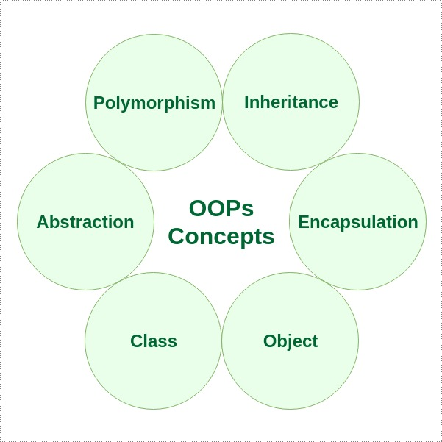
Introduction to object-oriented programming
Object-oriented programming – As the name suggests uses objects in programming.
Object-oriented programming aims to implement real-world entities like inheritance, hiding, polymorphism, etc in programming.
The main aim of OOP is to bind together the data and the functions that operate on them so that no other part of the code can access this data except that function.

Slide 4
Introduction to object-oriented programming Contd..
Object oriented programming can be defined as a programming model which is based upon the concept of objects.
Objects contain data in the form of attributes and code in the form of methods. In object oriented programming, computer programs are designed using the concept of objects that interact with real world. (behavior shows the functionality of object)
Object oriented programming languages are various but the most popular ones are class-based, meaning that objects are instances of classes, which also determine their types.
Class is a group of similar objects. (Student)----S1, S2, S3----Roll_no, Name
Languages used in Object Oriented Programming:
Java, C++, C#, Python,
PHP, JavaScript, Ruby, Perl,
Objective-C, Dart, Swift, Scala.

Slide 5
Basic concept of Procedural Oriented Programming
Procedural Programming can be defined as a programming model which is derived from structured programming, based upon the concept of calling procedure.
Procedures, also known as routines, subroutines or functions, simply consist of a series of computational steps to be carried out.
During a program’s execution, any given procedure might be called at any point, including by other procedures or itself.
Languages used in Procedural Programming:
FORTRAN, ALGOL, COBOL,
BASIC, Pascal and C.

Slide 6
Comparison POP vs OOP
Procedural Oriented Programming | Object Oriented Programming
In procedural programming, program is divided into small parts called functions. | In object oriented programming, program is divided into small parts called objects.
Procedural programming follows top down approach. | Object oriented programming follows bottom up approach.
There is no access specifier in procedural programming. | Object oriented programming have access specifiers like private, public, protected etc.
Adding new data and function is not easy. | Adding new data and function is easy.
Procedural programming does not have any proper way for hiding data so it is less secure. | Object oriented programming provides data hiding so it is more secure.
In procedural programming, overloading is not possible. | Overloading is possible in object oriented programming.
In procedural programming, function is more important than data. | In object oriented programming, data is more important than function.
Procedural programming is based on unreal world. | Object oriented programming is based on real world.
Examples: C, FORTRAN, Pascal, Basic etc. | Examples: C++, Java, Python, C# etc.

Slide 7
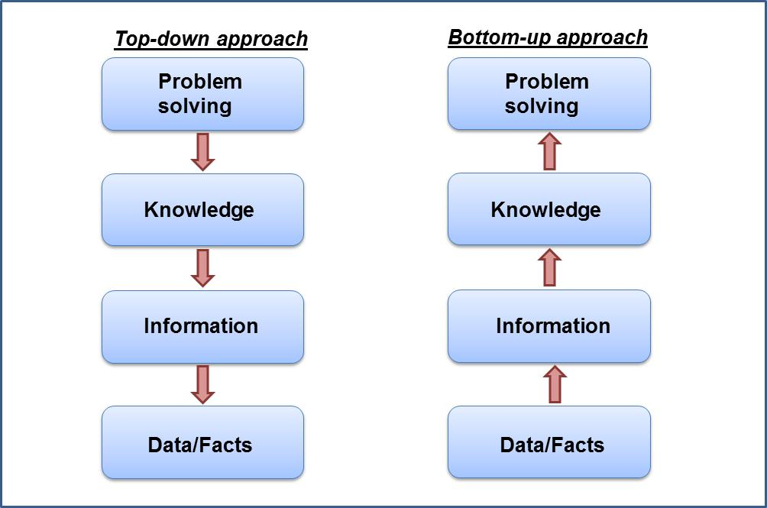
Comparison POP vs OOP Contd..

Slide 8
Structure Vs Class
Class | Structure
Members of a class are private by default. | Members of a structure are public by default.
Memory allocation happens on the heap. | Memory allocation happens on a stack.
It is a reference type data type. | It is a value type data type.
It is declared using the class keyword. | It is declared using the struct keyword.

Slide 9
Class Student
{
Int Roll_no;
String name;
};
int main()
{
A();
Student s1;
s1.Roll_no = 101; //initialize
S1.name = “Anu”;
}

Slide 10
Structure of a C++ program
A C++ program is structured in a specific and particular manner. In C++, a program is divided into the following sections:
Document Section
Link Section
Specifying Namespace
Global Definition and Declaration Section
Main Program Section
Sub Program Section

Slide 11
Structure of a C++ program Contd..
Documentation section
Documentation section is generally meant include “set of comments”, that is used to provide the information about the program written like name of a program, utility of program, date of creation, date of last modification ,author name, licensing or copyrights information and any other information that programmer wish to put for the references.
//Program Name: First C++ Program /* Version: 1.0 Description: C++ program basic program structure. Author: @noname Date Created:05-07-2021 */

Slide 12
Structure of a C++ program Contd..
Link Section
Preprocessors directives tell the compiler to preprocess the source code before compiling.
All of these preprocessor directives begin with a ‘#’ (hash) symbol. The ‘#’ symbol indicates that, whatever statement starts with #, is going to the preprocessor program, and preprocessor program will execute this statement.
Examples of some preprocessor directives are: #include, #define, #ifndef etc.

Slide 13
Structure of a C++ program Contd..
Preprocessor Directives
There are 3 main types of preprocessor directives:
Macros
File Inclusion
Other directives

Slide 14
Structure of a C++ program Contd..
Macros
Macros are a piece of code in a program which is given some name. Whenever this name is encountered by the compiler the compiler replaces the name with the actual piece of code.
The ‘#define’ directive is used to define a macro.
#include<iostream>
using namespace std;
// macro definition
#define LIMIT 5
#define c "czechoslovakia"
int main()
{
for (int i = 0; i < LIMIT; i++)
{
cout << i << "\n";
}
cout<<c;
return 0;
}

Slide 15
Structure of a C++ program Contd..
Macros with arguments: We can also pass arguments to macros. Macros defined with arguments works similarly as functions.
#include <iostream>
Using namespace std;
// macro with parameter
#define AREA(l, b) (l * b)
int main()
{
int l1 = 10, l2 = 5, area;
area = AREA(l1, l2);
std::cout << "Area of rectangle is: " << area;
return 0;
}

Slide 16
Structure of a C++ program Contd..
File Inclusion
This type of preprocessor directive tells the compiler to include a file in the source code program. There are two types of files which can be included by the user in the program:
Header File or Standard files:
#include< file_name >
where file_name is the name of file to be included. The ‘<‘ and ‘>’ brackets tells the compiler to look for the file in standard directory.
User defined files: When a program becomes very large, it is good practice to divide it into smaller files and include whenever needed. These types of files are user defined files. These files can be included as:
#include"filename"

Slide 17
Structure of a C++ program Contd..
Other Directives
Conditional Compilation
Conditional Compilation directives are type of directives which helps to compile a specific portion of the program or to skip compilation of some specific part of the program based on some conditions. This can be done with the help of two preprocessing commands ‘ifdef‘ and ‘endif‘.
#undef Directive:
The #undef directive is used to undefine an existing macro.
#ifdef macro_name
statement1;
statement2;
statement3;
.
.
statementN;
#endif
#undef LIMIT

Slide 18
Structure of a C++ program Contd..
Global Declaration and definition
This is the section where all the global declaration comes. All of the variables, structures, classed and function defined or declared outside the main function are treated as global.
#include <iostream> #define PI 3.142 #define TRUE 1 int a=10; //global declaration & definition Int main() { int b=20; cout<<a<<b; }

Slide 19
Structure of a C++ program Contd..
Namespaces
A namespace permits grouping of various entities like classes, objects, functions, and various C++ tokens, etc. under a single name.
Any user can create separate namespaces of its own and can use them in any other program.
In the below snippets, namespace std contains declarations for cout, cin, endl, etc. statements.
using namespace std;
Namespaces can be accessed in multiple ways:
using namespace std;
using std :: cout;

Slide 20
Structure of a C++ program Contd..
Main Program Section
int main()
{
cout << "Hello World" << endl;
return 0;
}
The starting point of all C++ programs is the main function.
This function is called by the operating system when your program is executed by the computer.
{ signifies the start of a block of code, ​and } signifies the end.

Slide 21
Structure of a C++ program Contd..
Subprogram Section
This is the section of where we put all the user defined functions other than main function created to perform specific tasks.
A user defined function must be defined before use it. User defined function can written before or immediately after the main () function and called inside the main () function.
#include<iostream> using namespace std; int main() { cout<<"Hello Everyone!\n"; subprogram(); return 0; } void subprogram() { cout<<“Welcome to Chitkara !"; }

Slide 22
Structure of a C++ program Contd..
Example //Program to demonstrate structure of C++ Program documentation section #include<iostream> link section using namespace std; #define w “Welcome to Chitkara University” macro definition int a=10; global declaration & definition int main() main program section { int b=20; local declaration & definition int c; cout<<w<<endl; c=a+b; sub(); subprogram call cout<<“the answer is”<<c; return 0; } void sub() subprogram definition section { cout<<“this is subprogram’s statement”; }

Slide 23
Program No. 1
#include <iostream>
using namespace std;
class Student {
int id;//data member (also instance variable)
string name;//data member(also instance variable)
};
int main() {
Student s1; //creating an object of Student
s1.id = 201;
s1.name = "Sonoo Jaiswal";
Cin>>s1.id>>endl;
cout<<s1.id<<endl; \\print
cout<<s1.name<<endl;
return 0;
}

Slide 24
Code Compilation Process
C++ Source Code
Are There any Preprocessor Directive
Yes
No
Compiler
Preprocessor Perform Action
Object Code
Linker
Executable Code

Slide 25
Keywords In C++
A keyword is a reserved word. You cannot use it as a variable name, constant name etc. A list of 32 Keywords in C++ Language which are also available in C language are given below.
auto | break | case | char | const | continue | default | do
double | else | enum | extern | float | for | goto | if
int | long | register | return | short | signed | sizeof | static
struct | switch | typedef | union | unsigned | void | volatile | while

Slide 26
Data Types
A data type determines the type and the operations that can be performed on the data. C++ provides various data types and each data type is represented differently within the computer’s memory.
The various data types provided by C++ are built-in data types, derived data types and user-defined data types.

Slide 27
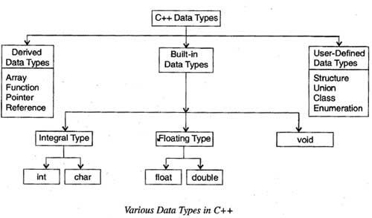
Data Types Contd..

Slide 28
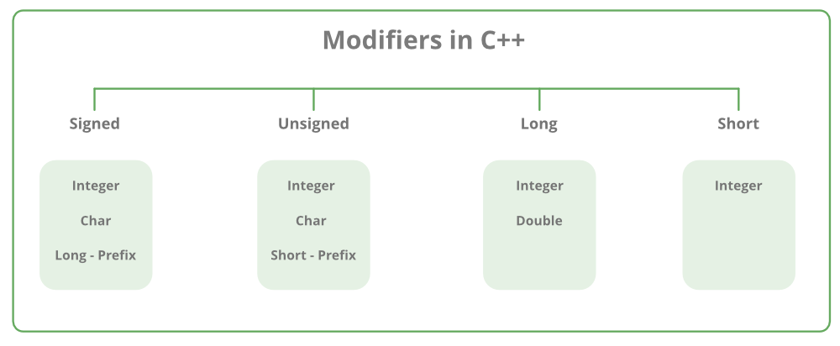
Data Types Contd..
Data Type Modifiers
As the name implies, datatype modifiers are used with the built-in data types to modify the length of data that a particular data type can hold.

Slide 29
Data Types Contd..
Data Type | Size (in bytes) | Range
short int | 2 | -32,768 to 32,767
unsigned short int | 2 | 0 to 65,535
unsigned int | 4 | 0 to 4,294,967,295
int | 4 | -2,147,483,648 to 2,147,483,647
long int | 4 | -2,147,483,648 to 2,147,483,647
unsigned long int | 8 | 0 to 4,294,967,295
long long int | 8 | -(2^63) to (2^63)-1
unsigned long long int | 8 | 0 to 18,446,744,073,709,551,615
signed char | 1 | -128 to 127
unsigned char | 1 | 0 to 255
Float | 4 | 1.2E-38 to 3.4E+38
double | 8 | 2.3E-308 to 1.7E+308
long double | 10 | 3.4E-4932 to 1.1E+4932
wchar_t | 2 or 4 | 1 wide character

Slide 30
C++ Variables
A variable is a name given to a memory location. It is the basic unit of storage in a program.
The value stored in a variable can be changed during program execution.
A variable is only a name given to a memory location, all the operations done on the variable effects that memory location.
In C++, all the variables must be declared before use.

Slide 31
C++ Variables Contd..
A typical variable declaration is of the form:
// Declaring a single variable
type variable_name;
// Declaring multiple variables:
type variable1_name, variable2_name, variable3_name;
int x;
Int X;
int roll no; (not valid)
Int roll_no;
int x1;
Int 1x; (invalid)
A variable name can consist of alphabets (both upper and lower case), numbers and the underscore ‘_’ character. However, the name must not start with a number.

Slide 32
C++ Variables Contd..

Slide 33
C++ Variables Contd..
Scope of Variables
In general, the scope is defined as the extent up to which something can be worked with. In programming also the scope of a variable is defined as the extent of the program code within which the variable can we accessed or declared or worked with.
There are mainly two types of variable scopes:
Local Variables
Global Variables

Slide 34
C++ Variables Contd..
Local Variables
Variables defined within a function or block are said to be local to those functions.
Anything between ‘{‘ and ‘}’ is said to inside a block.
Local variables do not exist outside the block in which they are declared, i.e. they can not be accessed or used outside that block.
Declaring local variables: Local variables are declared inside a block.

Slide 35
C++ Variables Contd.
#include <iostream>
using namespace std;
void test();
int main()
{
// local variable to main()
int var = 5;
test(); //call the function
// illegal: var1 not declared inside main()
var1 = 9;
}
void test()
{
// local variable to test()
int var1;
var1 = 6;
// illegal: var not declared inside test()
cout << var;
}

Slide 36
C++ Variables Contd.
Global Variables
As the name suggests, Global Variables can be accessed from any part of the program.
They are available through out the life time of a program.
They are declared at the top of the program outside all of the functions or blocks.
Declaring global variables: Global variables are usually declared outside of all of the functions and blocks, at the top of the program. They can be accessed from any portion of the program.

Slide 37
C++ Variables Contd.
#include<iostream>
using namespace std;
int global = 5; //Global variables
void display()
{
cout<<global<<endl;
}
int main()
{
display(); //calling of function //5
// changing value of global variable from main function
global = 10;
display(); //10
}

Slide 38
#include<iostream>
using namespace std;
// Global variable declaration
int c = 12;
void test();
int main()
{
++c; c++;
// Outputs 13
cout << c <<endl;
test();
return 0;
}
void test()
{
++c;
// Outputs 14
cout << c;
}

Slide 39
C++ Operators
Operators are symbols that perform operations on variables and values.
Arithmetic Operators (+ - * / %)
Relational Operators (< > <= >= == !=)
Logical Operators ( && || !)
Conditional Operator (? :)
Special Operators
#include<iostream>using namespace std;class patient{ public: int srno; int fees; void fun(int x,int y){ x=srno; y=fees; } };class doctor{ public: int srno,salary; void fun(int x,int y){ x=srno; y=salary; cout<<x<<y; }};int main(){ patient obj; int x,y,z,m,n; cin>>x>>y; obj.fun(x,y); doctor obj1; cin>>m>>n; obj1.fun(m,n); cout<<m<<n; }

Slide 40
C++ Operators Contd..
Special Operators
Increment/Decrement
Comma, Semicolon
Dot, Arrow
New & Delete
Scope Resolution
Insertion and Extraction
Bitwise
Assignment
Sizeof
& and *
Cast

Slide 41
C++ Operators Contd..
Bitwise Operators
Bitwise operator works on bits and perform bit-by-bit operation. The truth tables for &, |, and ^ are as follows −
p | q | p & q | p | q | p ^ q
0 | 0 | 0 | 0 | 0
0 | 1 | 0 | 1 | 1
1 | 1 | 1 | 1 | 0
1 | 0 | 0 | 1 | 1

Slide 42
C++ Operators Contd..
The Bitwise operators supported by C++ language are listed in the following table. Assume variable A holds 60 and variable B holds 13, then
Operator | Description | Example
& | Binary AND Operator copies a bit to the result if it exists in both operands. | (A & B) will give 12 which is 0000 1100
| | Binary OR Operator copies a bit if it exists in either operand. | (A | B) will give 61 which is 0011 1101
^ | Binary XOR Operator copies the bit if it is set in one operand but not both. | (A ^ B) will give 49 which is 0011 0001
~ | Binary Ones Complement Operator is unary and has the effect of 'flipping' bits. | (~A ) will give -61 which is 1100 0011 in 2's complement form due to a signed binary number.
<< | Binary Left Shift Operator. The left operands value is moved left by the number of bits specified by the right operand. | A << 2 will give 240 which is 1111 0000
>> | Binary Right Shift Operator. The left operands value is moved right by the number of bits specified by the right operand. | A >> 2 will give 15 which is 0000 1111

Slide 43
C++ Operators Contd..
Assignment Operators
There are following assignment operators supported by C++ language
Operator | Description | Example
= | Simple assignment operator, Assigns values from right side operands to left side operand. | C = A + B will assign value of A + B into C
+= | Add AND assignment operator, It adds right operand to the left operand and assign the result to left operand. | C += A is equivalent to C = C + A
-= | Subtract AND assignment operator, It subtracts right operand from the left operand and assign the result to left operand. | C -= A is equivalent to C = C - A

Slide 44
Assignment-1(Submit on 10-03-2022)
Write a program in C++ to add two numbers accept through keyboard.
Write a program in C++ to find Size of fundamental data types.
Write a program in C++ to display the operation of pre and post increment and decrement.
Write a program in C++ to swap two numbers using third variable.
Write a program in C++ which swap the values of two variables not using third variable.

Slide 45
Thanks

